Slide 1
Study of the interactions between stakeholders by a multi-agents system Application to the Common Pool Resources in Miarinarivo district (Madagascar)
2014
Gaudieux^{(a)}, Kwan^{(b)}, Gangat and Courdier^{(c)}
^{a)}Centre of Economics and Management of the Indian Ocean, University of Reunion Island (CEMOI)
and Laboratory of Computer Science and Mathematics (LIM), Saint-Denis, Reunion Island ^{(b)}Higher School Reunion Indian Ocean Engineering (ESIROI), Saint-Denis, Reunion Island ^{(c)}Laboratory of Computer Science and Mathematics (LIM), University of Reunion Island,
Saint-Denis, Reunion Island {aurelie.gaudieux, joel.kwan, yassine.gangat,remy.courdier}@univ-reunion.fr

Slide 2
WHAT IS SIEGMAS ?
The SIEGMAS model (Stakeholders Interactions in Environmental Governance by a Multi-Agent System) shows the interest of using a multi-agent simulation to build new alternatives to existing approaches in the context of decision support to implement Common Pool Resources governance policies. Agent Based Simulation (ABS) that were used in community complex systems offer an innovative approach to this field of economic and environmental study where non management transfer modeling has yet been made for all the island territories in the Indian Ocean.
SIEGMAS is a modeling conceptualized in order to study the deviances of the farmers against the forester and natural resources protected by the management's transfers or another text of law.
Notes:
In the context of this project, the economic and classic steps being limited enough for the conceptualisation of the individuals' behaviours and the process of common pool resources, an approach called MAS allows some improvements in the study of these phenomenon and the creation of a sales tool for the decision. this establishment of a model must check if the management's transfers are efficacious via the application of penalties and to study the actors' strategies as well as their behaviours.

Slide 3
COMMON POOL RESOURCES (CPR) ?
The Common Pool Resources points out the efficient application from the strategies of sustainable developments to common goods thanks to the decentralization of powers to the regional authorities.
In 1990, Elinor Ostrom establishes a theory of common natural run in common by the stakeholders for more performance. In addition, for Ostrom (Ostrom, 2010), the local governance comes under the interrelations between a beam of disciplines; it comes as a political, social, legal and economic problem.
The Common Pool Resources emerged from the ninth Century in Malagasy environmental law and became intensified with the translation of French law under the French colonial era (1864-1960).
Notes:
The Common Pool Resources points out the efficient application from the strategies of sustainable developments to common goods thanks to the
decentralization of powers to the regional authorities.
This approach is applied in various countries like the
developing countries which, facing the inexorable
destruction of the organic diversity, seeks an efficacious
and local management, (Wade 1987) by adopting an
environmental regulation in favor of the management of
resources (Alden Willy 2004). The management's
transfers allow the governments to decentralize the
management of natural resources to the defined actors
in this process. In 1990, Elinor Ostrom establishes a
theory of common natural run in common by the
stakeholders for more performance. In addition, for
Ostrom (Ostrom, 2010), the local governance comes
under the interrelations between a beam of discipline; it
comes as a political, social, legal and economic
problem.
The Common Pool Resources emerged from the ninth Century in Malagasy environmental law and became intensified with the translation of French law under the French colonial era (1864-1960). The decade 1990 marks a real turning point in law of Malagasy environment with the apparition of the laws in favor of the safeguarding of common goods. Thus, the Charter of Environment in 1990, Law N° 90-033, the Gélose law (Secured Local Management) and the Contracted Management of Forests mark the emergence of a real consensus for Environment in Madagascar by the establishment of the management's transfers.
The Gélose Contract, Law N° 96-025 of 30 September 1996, for the local management of natural renewable of resources establishes a general framework for the preservation of the territory resources and its ecosystem. The Gélose Contract is composed of a contract of a management transfer, which contains a bill of specifications, the Dina controlling the basis community also called the COBA and a simplified land inventory known under the name of a collect Relative Security Land. The whole of stakeholders (Wade 1987) participates in the creation of the contract about the management's transfer signed by the COBA, the town and the local government representatives.
The Contracted Management of Forests, CMF, established by the decree N° 2001/122 of 14th February 2001, simplifies the procedure of the Gélose Contract but its duration is the same as one Gélose Contract: three years for the initial contract which can be renewed after a control for 10 years. We can count two parts for this contract: the forestry administration and the COBA. The community, as the secondary actor raises awareness and informs the COBA.
Since the coming into force of the management transfer contracts in 1999, more than 2000 contracts have been signed in Madagascar. These transfers have been converged by a strengthening of awareness and the application of sanctions. The good application of the transfers depends on the interactions between the actors and the controls.

Slide 4
COMMON POOL RESOURCES (CPR) ?
The Gélose Contract, Law N° 96-025 of 30 September 1996, for the local management of natural renewable of resources establishes a general framework for the preservation of the territory resources and its ecosystem.
The Contracted Management of Forests, CMF, established by the decree N° 2001/122 of 14th February 2001, simplifies the procedure of the Gélose Contract but its duration is the same as one Gélose Contract: three years for the initial contract which can be renewed after a control for 10 years.
Since the coming into force of the management transfer contracts in 1999, more than 2000 contracts have been signed in Madagascar.

Slide 5
WHY MAS ?
The structuring of environmental models constitutes a starting point unavoidable for the development of our establishment of a model (Müller and Aubert 2012) and (Bousquet and al. 2001).
Several cross-disciplinary and economic methods are conceivable for the study of natural resources and interactions. However, they hardly model the interactions between the stakeholders. The methods of the market's efficiencies and general economy focus on the relative analysis to the market's value and the theories of the growth and the models of Calculable general balance.
The environmental methods
The methods relative to the ecological. The economy biodiversity in the methods of economic calculations remains controversial and limited (Nunes, Van den Bergh and Nijkamp, 2001).
The cross-disciplinary methods focus on law economy and the ABS.
The MAS have been choosed because they provide directly some pioneer tools for the problem.
Notes:
State of art
The structuring of environmental models constitutes a starting point unavoidable for the development of our establishment of a model (Müller and Aubert 2012) and (Bousquet and al. 2001).
Several cross-disciplinary and economic methods are conceivable for the study of natural resources and interactions. However, they hardly model the interactions between the stakeholders. The methods of the market's efficiencies and general economy focus on the relative analysis to the market's value and the theories of the growth and the models of Calculable general balance.
The environmental methods used, focus on the analysis, mono or several criteria, the restorative or compensatory measures and the Eco-certification as well as the Eco-potentiality.
The methods relative to the ecological economy come under some indicators of biodiversity, the calculation of the ecological loan and some indicators relative to the national accounting. Moreover, the incorporation of biodiversity in the methods of economic calculations remains controversial and limited (Nunes, Van den Bergh and Nijkamp, 2001). The economic analysis ex ante and ex post of biodiversity focus on either rationality of the preservation (analysis, cost-profit and the social well-being earned for each invested euro) or the effectiveness from the strategy of retained preservation.
The cross-disciplinary methods focus on law economy and the ABS. We use ABS to optimize economics theories such as individual and collectives preferences (Arrow, 1951) to improve their performances.
The MAS have been choosed because they provide directly some pioneer tools for the problem.

Slide 6
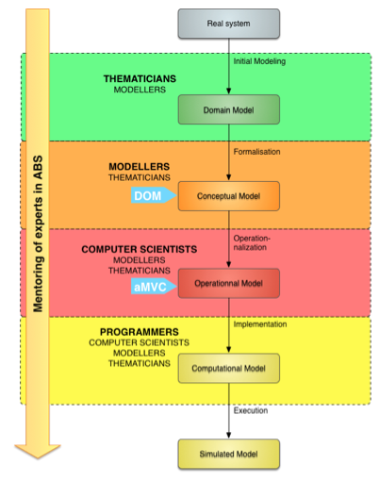
THE ESTABLISHMENT OF A MODEL
Figure - Core Curriculum to the methodologies
conception ABS
Notes:
We use an architecture, which allows us to describe the phases of our simulation (Ralambondrainy 2009). To create an ABS model for behavior and interactions between stakeholders, we use the method explained by (Gangat, 2013) that can be resumed in Figure 1

Slide 7
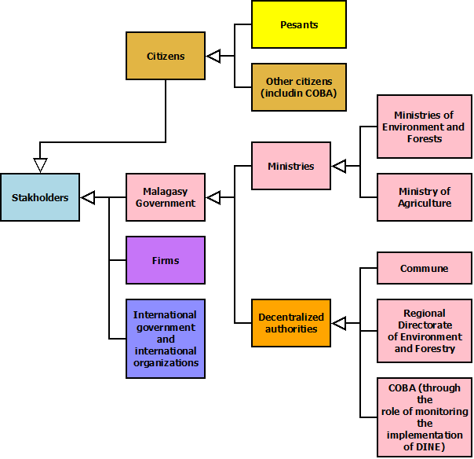
ONTOLOGIES
SIEGMAS models the interactions of the stakeholders in the context of the management's transfers in Miarinarivo District, the capital of the Itasy region (in Madagascar) thanks to the ABS approach. Itasy constitutes the smallest of the 22 regions from Madagascar in term of surface area with 6570 km2.
Four stakeholders compose the model

Slide 8
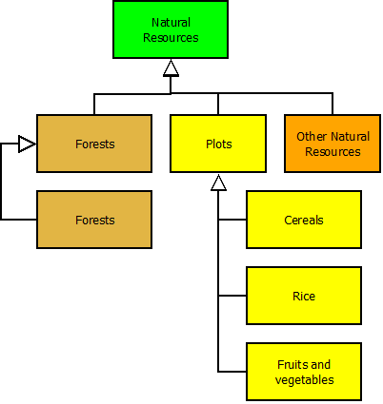
ONTOLOGIES
However, only the first two actors interest our model: the farmer and the Malagasy government. We chose to study the actors two by two in the different establishments of a model.
This study is focused in the forester and Common Pool Resources as well as the resources produced by the farms

Slide 9
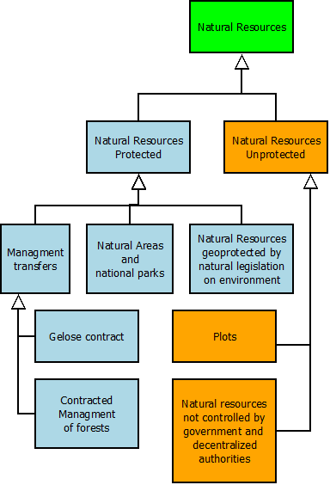
ONTOLOGIES
SIEGMAS
In this simulation, a patch represents an agricultural plot, or a plot of forest or natural resources.
Our environment of simulation is composed of 1936 plots, that is to say 44x44 patches. The surface area of Miarinarivo is 2818 km². The district is composed for the best part of natural resources and farms. The average surface of a plot hold by a farmer in the district rises to 1.4 hectares, which corresponds to about 1990 plots per a farmer in the model.

Slide 10


MANIPULATED ENTITIES
Entities | Representations in Netlogo
Peasants
Deviants
Exploitations
Plots
Forest
Pcolor : three colors Brown : Very deep agriculture at dominance on burnt land Orange : The bio agriculture Purple : The conventional agriculture

Slide 11
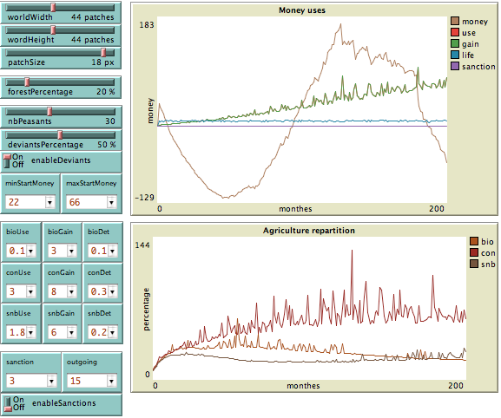
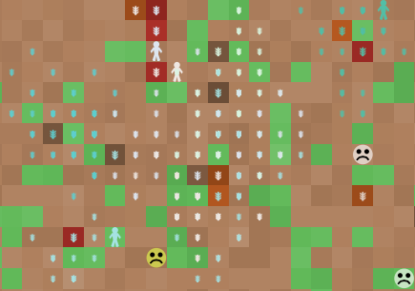
OVERVIEW OF SIMULATION
Representation of a situation of deviance with a deviants ratios of 50 %
Notes:
Organization of the model
The land is created according to a certain number of obligations given by the interface (Figure 6) like the size of the land, in number of patches, and the percentage of land, formulated in number of patches, and the percentage of land covered by the forest. We also distribute a determined number of farmers (from the interface) randomly on the in a way that they are not superimposed. Then, their farming are created around them in a radius going until 8 patches for now all by avoiding to use a patch already exploited or forbidden like the forest. For the farming of natural resources, the farmers exploit or try to exploit as much as possible resources neighboring their farming than the resources separated geographically.
The sanctions
The farmers can respect or transgress the legislation towards the protection of natural resources.
The controls or the rupture can identify the transgressions. The authorities grant some individual sanctions to the deviants. Thus, no collective sanction affects the respectful farmers of the legislation. Besides, the state laws for Environment, the laws and traditional rules like the Dina permit the excise of sanction based on the habits et traditions as well as the respect of nature.
Payment mandate of the process
Concept of elaboration
In our establishment of a model, the level of detail depends on the link between the number of patch and the actual size. Knowing that the smallest indivisible unity under the NetLogo is the patch, this latter will correspond to one type of land. A patch can point out either plot of forest, or a plot of farming and natural resources. Besides, a farmer adopts a unique mode of agriculture per a plot: organic, conventional or on burnt land. It does not exist any segregation about the plots.
The farmers have some information relative to the localization of the agar areas, under the GCF, some other resources under the environmental legislation and some farms of environment from the simulation. The farmers also know the farming, which belong to them. The government is not directly represented by an agent. It acts through the checks and the sanctions applied on the patches and the farmers.
In this simulation, we consider, basing upon the theory of games (Von Neuman and Morgenstern, 1944) that environment can be random and interdependent. In our simulation, the officers will exploit the neighboring plots or the forest illegally in order to maximize their profits. Thus, on one part, it is a matter of a random environment because the chance and the behavior of an officer in order to maximize his profits. Also an environment of interdependence because the collective behaviors and the individual behavior of an officer, i.e. his rationality, influence the maximization of these profits (Cavagnac 2006).
In the game where each of some n officers of the game chooses the behaviors maximizing his profit in the whole of the possible behaviors. In our establishment of a model, the games can be static or dynamic and the complete or incomplete information. In a static game, an officer acts (an action is a strategy) without knowing the behavior of another officer whereas they act simultaneously in a dynamic game. The strategies can be dominant or dominated. A whole of strategy is a balance of Nash (1950). When we maximize his expectations of profits basing upon his beliefs, the whole of strategies that he deploys is a « Bayesian » balance (Kreps and Wilson 1982). The plays can be also be repetitive or mixed (Kuhn and Tucker 1950).
Adaptation
The farmers set yourself in order to increase their productivity and to perpetuate the trust that the state authorities grant them (or to avoid the sanctions for everything by having a nearby context in favor of their activity. (Wade, 1987; Grüber, 1993; Bontems and Rotillon, 2007; Brandouy, Mathieu and Venryzhenko, 2012).
Figure 6 - Intitial conditions of simulation
Perception and interaction
The arbitrary data can be distinguished in this simulation.
Being a matter of different types of agriculture, the variable « Use » corresponds to the investments that the farmers make according to the type of agriculture adopted. Iteration allows getting the cost for 100 % of agriculture. A farmer makes no investments if he chooses the organic agriculture in iteration. However, if he either adopts conventional agriculture or burnt land, these investments are equivalent in an iteration.
Concerning the profits relative to the variable « Gain », they fluctuate in accordance with the type of agriculture chose by the farmer. For this simulation, the income that 100% of three types of agriculture bring will be given in some fields intended to this effect on the graphic interface. Likewise, the variable « Det » determines the variable « Det » shapeless of the deterioration level from the grounds of farming plots revealed in percentage in an iteration.
Being a matter of sanctions, at each iteration, we puncture some money in the form of fee to the farmer at each iteration for 100 % of damage created by an illegal farming on a patch. The rules and sanctions of the State are applied during the month through the check of some patches). The sanctions are applied by collecting money to the farmer when we calculate his income available at the end of the month via the variable « outgoing » which points out the maximal money spent by a farmer in order to « live » in an iteration (random).
The deterioration is made at random for the patches non exploited, « update-rawPatches ». Moreover, a random and natural deterioration «update-exploited Patches » applied for each farm according to the percentage and the type of agriculture. We also obtain, according to the percentage and the type of agriculture, the money spent for the farming as well as the money earned by the farmer. The sum, which a farmer has, is updated each month according to the results of their farming. This available sum of money can lead to a change of the types of agriculture being able to be random and dependent on the money from the money remaining to the farmer.
The deviant, « update-deviants », remarks the neighboring plots to his ones. Then, he will or not exploits a land that does not belong to him. If during a made control, the « government », acting through a check, notices that a non-exploited land normally can be in the major of case illegally exploited, it punishes the deviant responsible for the transgression by a fee to pay every month in accordance with the degradation of the patch run by the illegal farming.

Slide 12
Video Demo
FUTURE WORKS
perspectives and Conclusions
Thanks for your Attention
Notes:
After launching several times the simulation with different values of configurations, it appears by observing the variation of the rate of deviants that if the government controls the management's transfers correctly, the sanctions are well applied (fig. 7). The presence of the deviants engenders more deterioration of the lands. Some deviants avoid the sanctions and run some non taxable income. However, the application of the sanction to the deviants rebalances the system so that the deviants could not get any profits in the illegal practice of agriculture or the exploitation of natural resources. Thus, the individual behaviours will impact the collective behaviours if a farmer knows the gestures of his neighbouring. The farmer grants his trust to his neighbour when it is not a matter of a deviant. However, if he knows the acts of deviance of his neighbour, he will be more suspicious against him and he will denounce him.
Figure 8 - Representation of a situation of deviance
By fixing the rate of deviants at 50 %, we notice that the use of money which the farmer is going to derease then increase strongly whereas the individual profits of the farmer and the lifespan of the farmings will have tendency to remain stable. This intensive farming is going to decrease the lifespan of the farmings. The type of agriculture fluctuate and the conventional agriculture and on burnt land dominate. The sanctions are also less applied (fig. 9).
Video demo :
FUTURE WORKS
MASC is already a fully functional tool and responds more or less to the initial requirements mentioned in above parts of this paper. However, during our experiencing phases, we note that the tool can be improved to improve its effectiveness.
On the server side, an upgrade of the hosting plan would permit a usage of another programming language for example Java which allows to have a compiled server side application to improve the calculation time instead of an interpreted script. With Java, we could also ignore the passage of data through Apache server and prevent the flow of information between several services. The client side will directly communicate with the server side of the application.
The client side can also be optimized by modifying some functions and not using frameworks as it is now. The advantage of using frameworks is the time gained at developing the tools. Once the proof of concept is acquired, the next step of MASC is optimizations.
Then we can also add more feature on this tool. Actually, the tools only manipulate the space of the simulations. It could also permit to prepare the initialization of multi-agents such as auto-detecting and extracting positions of agents based on pattern on the image, setting up clusters of patches or boundaries
for agents. We could also expand the list of available multi-agents simulation platform languages to generalize the use of the tool and permit more members of the community of the domain of multi-agent systems to use it.
PERSPECTIVES AND CONCLUSIONS
The redundant problem of creating representation of a space in multi-agents systems leads us to find some useful tools to be more productive. We often use maps from GIS softwares, paper supports and other electronic documents that we want to set up in our simulations.
In this article, we presented MASC, a support tool for configuring multi-agent systems based on the information extracted from colors of bitmap images. MASC aims to provide a simplified user-friendly service for the acquisition of code snippets ready to use with multi-agent systems simulations platforms. Thereby, creating multiple configurations for a same modelling can be done quickly and easily, while allowing the users to focus on the data and the results of simulations. Moreover, MASC allows to effortlessly create several of more or less finely crisscrossed map for observing the evolution of agents on different scales and precisions. We could gain more time on configuration if the tool permits also the placement of the agents if needed.
Our purpose in this article was not to bring out the possibility to automate part of the implementation of a modelling, but rather to highlight the lack of user-friendly tools to simplify the initialization of a simulation, which we assessed in example and present to

